Slide 1
Presentation
GÉCZI-KIS Georgian-Marian
21/1/0855/009 52104475
DVIS4ILV - Data Visualization, Presentation and Real-Time Integration of Digital Products 2024

Slide 2
Data
The data I am using is “VideoGamesSales.csv”
It contains:
the names of 16.719 video games and data related to their publication (Platform, Year, Genre, Publisher, Developer)
how many units they sold in 4 regions: North America, Europe, Japan, others
Rating of the game; Users and Critics data, count and score for both
These 5 attributes have around 6600-8500 rows that are missing
Notes:
All the plots are interactive, but because they are just png, I will attach here the link to the html/ jupyter notebook file I have uploaded on Github, in the case you are interested to see more or use the interactive feature of Plotly.
https://github.com/George-Marian/SS24-IMC-3.INF/blob/main/Data%20Visualisation/Presentation/videoGamesSales-Visualisation-GECZIKIS.html

Slide 3
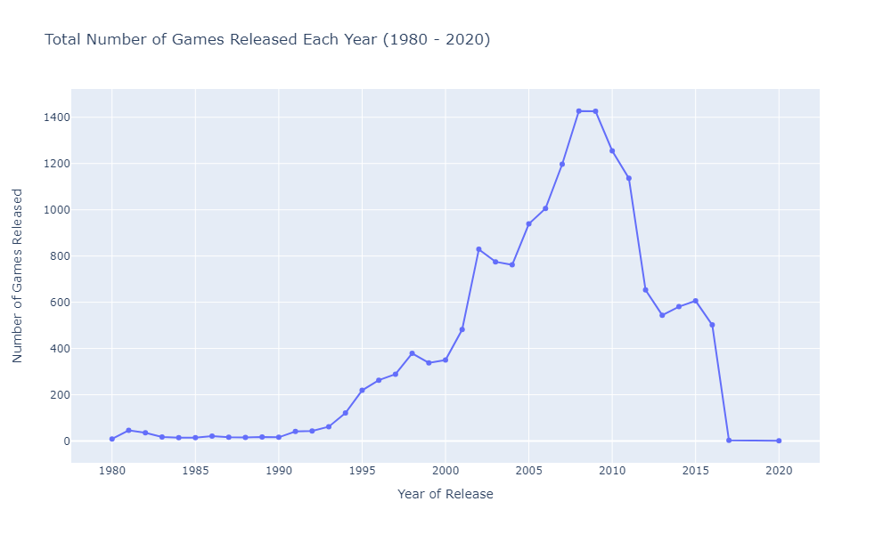
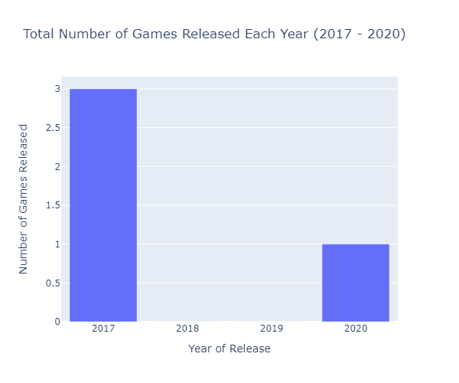
Insight 1
Notes:
The peak of the number of games released was in 2008 and 2009 (1427 and 1426 games), this proving that there might be existed a technological upgrade around that time or exactly before.
From 2017, the number of games from the data falls drastically, but this is more data related. I attached a picture of how many games are in the data in the period 2017-2020 (3 in 2017, 0 in 2018 and 2019, 1 in 2020) to show why the line chart is going up to 2020.
Initially I wanted to do a bar chart, but I realized that a line chart would show better the trends (number of games), because the line going from dot to dot is showing the increasing/decreasing values better than a bar chart, that is better for showing differences.
Describe the insight in the notes field and what to see in the visualization (1-2 sentences)
Explain why you selected this type of visualization (1 sentence

Slide 4
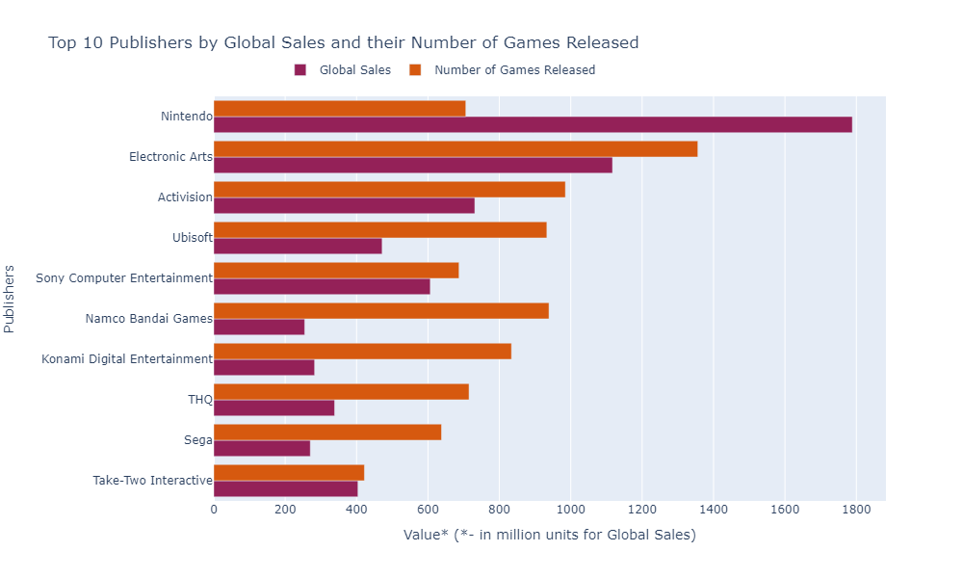
Insight 2
Notes:
The insight here is that most of the companies have a lot of games published in comparison with the sales they are reaching, except for Nintendo, that with a number of 706 games has reached 1788 millions units sold. In a way, It is showing that a company has a better quality (or likeability) of games if the quantity of games is smaller and the global sales bigger (Like Sony Computer and Take-Two Interactive)
I had a difficult time to find a way to mix these two attributes together, as I did initially 2 different horizontal bar charts of number of games released and global sales, but I saw the data fits together by the value numbers. It is a coincidence, as I realize this is not the best practice (because they have different kind of data).

Slide 5
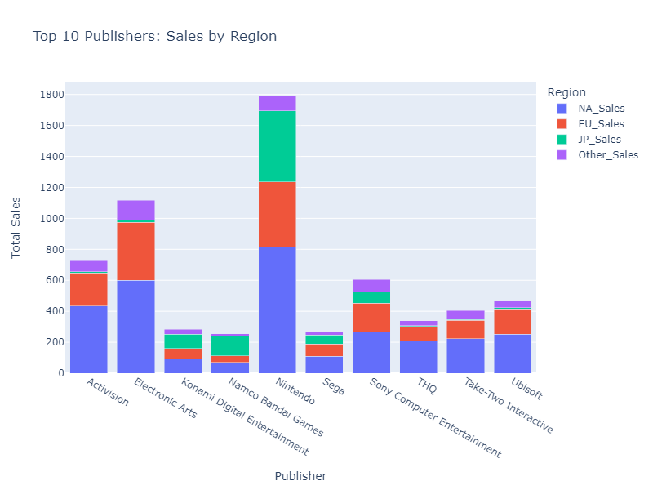
Insight 3
Notes:
This visualization shows top 10 companies and in which regions they are most successful. We can see than Nintendo got the most sales almost everywhere (except for Other Sales, where Electronic Arts is in lead), and also Nintendo is the lead in global sales. We also observe that, even if Electronic Arts, Activision, Sony, got a high percentage of the sales in North America and Europe, in Japan, the proportions are a little bit different (still Nintendo in Lead, but there are other companies on the other spots of the market).
I chose a stacked bar chart because I wanted a multivariate (Publisher, Global Sales, and regional sales: NA, JP, EU, Other) plot, and as all the regional sales get added to the global sales (I checked for that ☺), it suited the best.

Slide 6
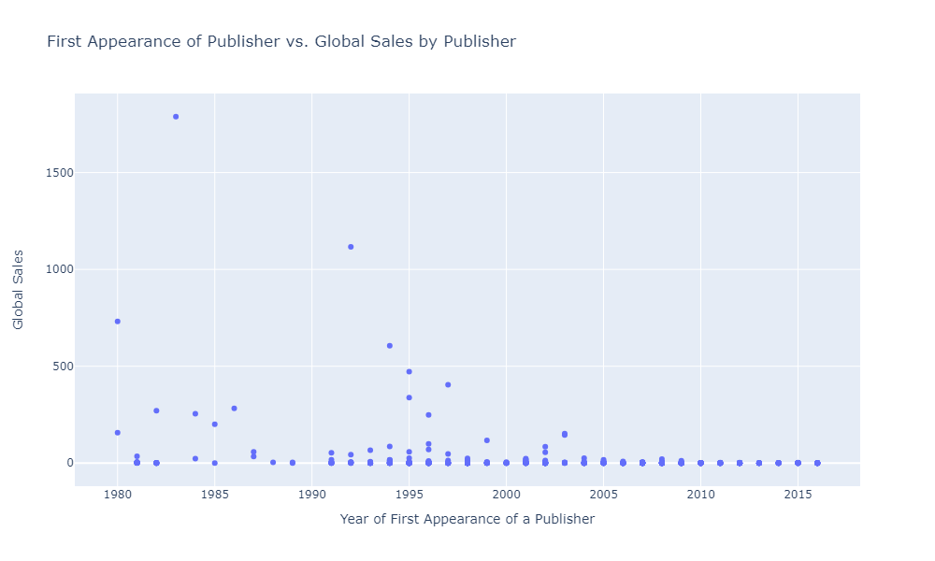
Interesting Insight (optional)
Notes:
This is a plot that I considered interesting, and I added as an optional plot, maybe you will like it too.
You can see that Global Sales are higher for the publishers that are older in the industry of video games. As I know, things don’t stay the same now, because some games got a boost of sales because of the speed of communication through social media, and Steam + Discord creating the social environment of a professional/casual gamer.
Having a lot of data, I chose a scatter plot to see the outliers.

